Slide 1
Chapter 3: Deadlocks
Chapter 3

Slide 2
Overview
Resources
Why do deadlocks occur?
Dealing with deadlocks
  Ignoring them: ostrich algorithm
  Detecting & recovering from deadlock
  Avoiding deadlock
  Preventing deadlock
CS 1550, cs.pitt.edu (originaly modified by Ethan L. Miller and Scott A. Brandt)
Chapter 3

Slide 3
Resources
Resource: something a process uses
  Usually limited (at least somewhat)
Examples of computer resources
  Printers
  Semaphores / locks
  Tables (in a database)
Processes need access to resources in reasonable order
Two types of resources:
  Preemptable resources: can be taken away from a process with no ill effects
  Nonpreemptable resources: will cause the process to fail if taken away
CS 1550, cs.pitt.edu (originaly modified by Ethan L. Miller and Scott A. Brandt)
Chapter 3

Slide 4
When do deadlocks happen?
Suppose
  Process 1 holds resource A and requests resource B
  Process 2 holds B and requests A
  Both can be blocked, with neither able to proceed
Deadlocks occur when …
  Processes are granted exclusive access to devices or software constructs (resources)
  Each deadlocked process needs a resource held by another deadlocked process
Process 1
Process 2
A
B
A
B
DEADLOCK!
CS 1550, cs.pitt.edu (originaly modified by Ethan L. Miller and Scott A. Brandt)
Chapter 3

Slide 5
Using resources
Sequence of events required to use a resource
  Request the resource
  Use the resource
  Release the resource
Can’t use the resource if request is denied
  Requesting process has options
    Block and wait for resource
    Continue (if possible) without it: may be able to use an alternate resource
    Process fails with error code
  Some of these may be able to prevent deadlock…
CS 1550, cs.pitt.edu (originaly modified by Ethan L. Miller and Scott A. Brandt)
Chapter 3

Slide 6
What is a deadlock?
Formal definition:
“A set of processes is deadlocked if each process in the set is waiting for an event that only another process in the set can cause.”
Usually, the event is release of a currently held resource
In deadlock, none of the processes can
  Run
  Release resources
  Be awakened
CS 1550, cs.pitt.edu (originaly modified by Ethan L. Miller and Scott A. Brandt)
Chapter 3

Slide 7
Four conditions for deadlock
Mutual exclusion
  Each resource is assigned to at most one process
Hold and wait
  A process holding resources can request more resources
No preemption
  Previously granted resources cannot be forcibly taken away
Circular wait
  There must be a circular chain of 2 or more processes where each is waiting for a resource held by the next member of the chain
CS 1550, cs.pitt.edu (originaly modified by Ethan L. Miller and Scott A. Brandt)
Chapter 3

Slide 8
Resource allocation graphs
Resource allocation modeled by directed graphs
Example 1:
  Resource R assigned to process A
Example 2:
  Process B is requesting / waiting for resource S
Example 3:
  Process C holds T, waiting for U
  Process D holds U, waiting for T
  C and D are in deadlock!
A
B
R
S
T
C
D
U
CS 1550, cs.pitt.edu (originaly modified by Ethan L. Miller and Scott A. Brandt)
Chapter 3

Slide 9

Resource Allocation Graph: Multiple Resources

Slide 10

Graph With A Cycle But No Deadlock

Slide 11
Basic Facts
If graph contains no cycles ⇒ no deadlock
If graph contains a cycle ⇒
  if only one instance per resource type, then deadlock
    necessary and sufficient condition
  if several instances per resource type, possibility of deadlock
    necessary condition

Slide 12
Dealing with deadlock
How can the OS deal with deadlock?
  Ignore the problem altogether!
    Hopefully, it’ll never happen…
  Detect deadlock & recover from it
  Dynamically avoid deadlock
    Careful resource allocation
  Prevent deadlock
    Remove at least one of the four necessary conditions
We’ll explore these tradeoffs
CS 1550, cs.pitt.edu (originaly modified by Ethan L. Miller and Scott A. Brandt)
Chapter 3

Slide 13
Getting into deadlock
A
B
C
Acquire R
Acquire S
Release R
Release S
Acquire S
Acquire T
Release S
Release T
Acquire T
Acquire R
Release T
Release R
A
B
C
A
B
C
A
B
C
R
S
T
R
S
T
R
S
T
Acquire R
Acquire S
Acquire T
A
B
C
A
B
C
A
B
C
R
S
T
R
S
T
R
S
T
Deadlock!
Acquire S
Acquire T
Acquire R
CS 1550, cs.pitt.edu (originaly modified by Ethan L. Miller and Scott A. Brandt)
Chapter 3

Slide 14
Not getting into deadlock…
Many situations may result in deadlock (but don’t have to)
  In previous example, A could release R before C requests R, resulting in no deadlock
  Can we always get out of it this way?
Find ways to:
  Detect deadlock and reverse it
  Stop it from happening in the first place
CS 1550, cs.pitt.edu (originaly modified by Ethan L. Miller and Scott A. Brandt)
Chapter 3

Slide 15
The Ostrich Algorithm
Pretend there’s no problem
Reasonable if
  Deadlocks occur very rarely
  Cost of prevention is high
UNIX and Windows take this approach
  Resources (memory, CPU, disk space) are plentiful
  Deadlocks over such resources rarely occur
  Deadlocks typically handled by rebooting
Trade off between convenience and correctness
CS 1550, cs.pitt.edu (originaly modified by Ethan L. Miller and Scott A. Brandt)
Chapter 3

Slide 16
Detecting deadlocks using graphs
Process holdings and requests in the table and in the graph (they’re equivalent)
Graph contains a cycle => deadlock!
  Easy to pick out by looking at it (in this case)
  Need to mechanically detect deadlock
Not all processes are deadlocked (A, C, F not in deadlock)
R
A
B
Process | Holds | Wants
A | R | S
B |  | T
C |  | S
D | U | S,T
E | T | V
F | W | S
G | V | U
C
S
D
T
E
F
U
V
W
G
CS 1550, cs.pitt.edu (originaly modified by Ethan L. Miller and Scott A. Brandt)
Chapter 3

Slide 17
Deadlock detection algorithm
General idea: try to find cycles in the resource allocation graph
Algorithm: depth-first search at each node
  Mark arcs as they’re traversed
  Build list of visited nodes
  If node to be added is already on the list, a cycle exists!
Cycle == deadlock
For each node N in the graph {
Set L = empty list
unmark all arcs
Traverse (N,L)
}
If no deadlock reported by now, there isn’t any
define Traverse (C,L) {
If C in L, report deadlock!
Add C to L
For each unmarked arc from C {
Mark the arc
Set A = arc destination
/* NOTE: L is a
local variable */
Traverse (A,L)
}
}
CS 1550, cs.pitt.edu (originaly modified by Ethan L. Miller and Scott A. Brandt)
Chapter 3

Slide 18
Resources with multiple instances
Previous algorithm only works if there’s one instance of each resource
If there are multiple instances of each resource, we need a different method
  Track current usage and requests for each process
  To detect deadlock, try to find a scenario where all processes can finish
  If no such scenario exists, we have deadlock
CS 1550, cs.pitt.edu (originaly modified by Ethan L. Miller and Scott A. Brandt)
Chapter 3

Slide 19
Deadlock detection algorithm
 | A | B | C | D
Avail | 2 | 3 | 0 | 1
current=avail;
for (j = 0; j < N; j++) {
for (k=0; k<N; k++) {
if (finished[k])
continue;
if (want[k] < current) {
finished[k] = 1;
current += hold[k];
break;
}
if (k==N) {
printf “Deadlock!\n”;
// finished[k]==0 means process is in
// the deadlock
break;
}
}
Process | A | B | C | D
1 | 0 | 3 | 0 | 0
2 | 1 | 0 | 1 | 1
3 | 0 | 2 | 1 | 0
4 | 2 | 2 | 3 | 0
Hold
Process | A | B | C | D
1 | 3 | 2 | 1 | 0
2 | 2 | 2 | 0 | 0
3 | 3 | 5 | 3 | 1
4 | 0 | 4 | 1 | 1
Want
Note: want[j],hold[j],current,avail are arrays!
CS 1550, cs.pitt.edu (originaly modified by Ethan L. Miller and Scott A. Brandt)
Chapter 3

Slide 20
Detection-Algorithm Usage
When, and how often, to invoke depends on:
  How often a deadlock is likely to occur?
  How many processes will need to be rolled back?
    one for each disjoint cycle
If detection algorithm is invoked arbitrarily, there may be many cycles in the resource graph and so we would not be able to tell which of the many deadlocked processes “caused” the deadlock.

Slide 21
Recovering from deadlock: options
Recovery through resource preemption
  Take a resource from some other process
  Depends on nature of the resource and the process
Recovery through rollback
  Checkpoint a process periodically
  Use this saved state to restart the process if it is found deadlocked
  May present a problem if the process affects lots of “external” things
Recovery through killing processes
  Crudest but simplest way to break a deadlock: kill one of the processes in the deadlock cycle
  Other processes can get its resources
  Preferably, choose a process that can be rerun from the beginning
    Pick one that hasn’t run too far already
CS 1550, cs.pitt.edu (originaly modified by Ethan L. Miller and Scott A. Brandt)
Chapter 3

Slide 22
Deadlock Recovery: Process Termination
Abort all deadlocked processes
Abort one process at a time until the deadlock cycle is eliminated
In which order should we choose to abort?
  Priority of the process
  How long process has computed, and how much longer to completion
  Resources the process has used
  Resources process needs to complete
  How many processes will need to be terminated
  Is process interactive or batch?

Slide 23
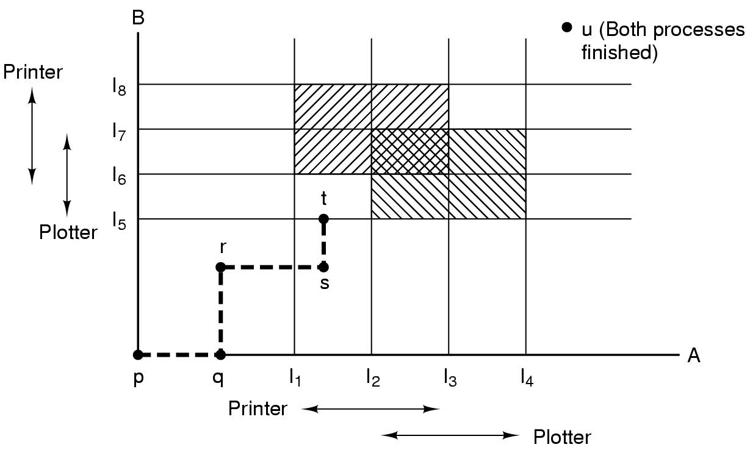
Resource trajectories
Two process resource trajectories
CS 1550, cs.pitt.edu (originaly modified by Ethan L. Miller and Scott A. Brandt)
Chapter 3

Slide 24
Safe and unsafe states
 | Has | Max
A | 3 | 9
B | 2 | 4
C | 2 | 7
Free: 3
 | Has | Max
A | 3 | 9
B | 4 | 4
C | 2 | 7
Free: 1
 | Has | Max
A | 3 | 9
B | 0 | -
C | 2 | 7
Free: 5
 | Has | Max
A | 3 | 9
B | 0 | -
C | 7 | 7
Free: 0
 | Has | Max
A | 3 | 9
B | 0 | -
C | 0 | -
Free: 7
Demonstration that the first state is safe
 | Has | Max
A | 3 | 9
B | 2 | 4
C | 2 | 7
Free: 3
 | Has | Max
A | 4 | 9
B | 2 | 4
C | 2 | 7
Free: 2
 | Has | Max
A | 4 | 9
B | 4 | 4
C | 2 | 7
Free: 0
 | Has | Max
A | 4 | 9
B | 0 | -
C | 2 | 7
Free: 4
Demonstration that the second state is unsafe
CS 1550, cs.pitt.edu (originaly modified by Ethan L. Miller and Scott A. Brandt)
Chapter 3

Slide 25
Banker's Algorithm for a single resource
 | Has | Max
A | 0 | 6
B | 0 | 5
C | 0 | 4
D | 0 | 7
Free: 10
 | Has | Max
A | 1 | 6
B | 1 | 5
C | 2 | 4
D | 4 | 7
Free: 2
 | Has | Max
A | 1 | 6
B | 2 | 5
C | 2 | 4
D | 4 | 7
Free: 1
Any sequence finishes
C,B,A,D finishes
Deadlock (unsafe state)
Bankers’ algorithm: before granting a request, ensure that a sequence exists that will allow all processes to complete
  Use previous methods to find such a sequence
  If a sequence exists, allow the requests
  If there’s no such sequence, deny the request
Can be slow: must be done on each request!
CS 1550, cs.pitt.edu (originaly modified by Ethan L. Miller and Scott A. Brandt)
Chapter 3

Slide 26
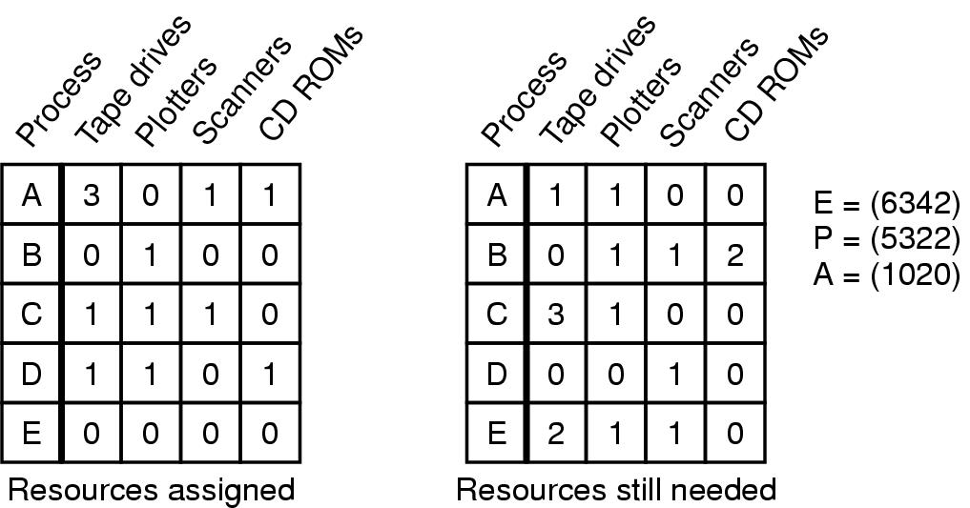
Banker's Algorithm for multiple resources
Example of banker's algorithm with multiple resources
CS 1550, cs.pitt.edu (originaly modified by Ethan L. Miller and Scott A. Brandt)
Chapter 3

Slide 27
Preventing deadlock
Deadlock can be completely prevented!
Ensure that at least one of the conditions for deadlock never occurs
  Mutual exclusion
  Circular wait
  Hold & wait
  No preemption
Not always possible…
CS 1550, cs.pitt.edu (originaly modified by Ethan L. Miller and Scott A. Brandt)
Chapter 3

Slide 28
Eliminating mutual exclusion
Some devices (such as printer) can be spooled
  Only the printer daemon uses printer resource
  This eliminates deadlock for printer
Not all devices can be spooled
Principle:
  Avoid assigning resource when not absolutely necessary
  As few processes as possible actually claim the resource
CS 1550, cs.pitt.edu (originaly modified by Ethan L. Miller and Scott A. Brandt)
Chapter 3

Slide 29
Attacking “hold and wait”
Require processes to request resources before starting
  A process never has to wait for what it needs
This can present problems
  A process may not know required resources at start of run
  This also ties up resources other processes could be using
    Processes will tend to be conservative and request resources they might need
Variation: a process must give up all resources before making a new request
  Process is then granted all prior resources as well as the new ones
  Problem: what if someone grabs the resources in the meantime—how can the process save its state?
CS 1550, cs.pitt.edu (originaly modified by Ethan L. Miller and Scott A. Brandt)
Chapter 3

Slide 30
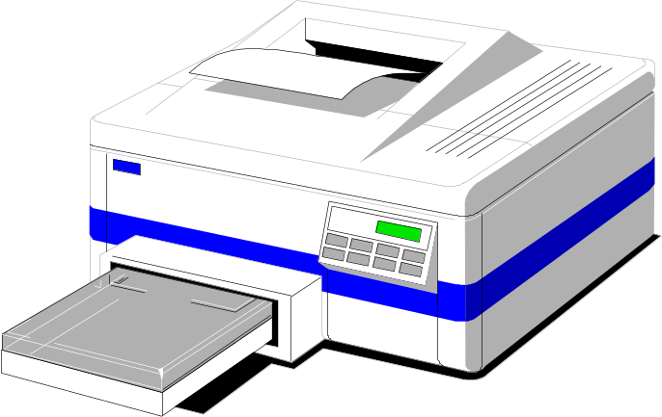
Attacking “no preemption”
This is not usually a viable option
Consider a process given the printer
  Halfway through its job, take away the printer
  Confusion ensues!
May work for some resources
  Forcibly take away memory pages, suspending the process
  Process may be able to resume with no ill effects
CS 1550, cs.pitt.edu (originaly modified by Ethan L. Miller and Scott A. Brandt)
Chapter 3

Slide 31
Attacking “circular wait”
Assign an order to resources
Always acquire resources in numerical order
  Need not acquire them all at once!
Circular wait is prevented
  A process holding resource n can’t wait for resource m
  if m < n
  No way to complete a cycle
    Place processes above the highest resource they hold and below any they’re requesting
    All arrows point up!
D
C
3
2
B
1
A
CS 1550, cs.pitt.edu (originaly modified by Ethan L. Miller and Scott A. Brandt)
Chapter 3

Slide 32
Deadlock prevention: summary
Mutual exclusion
  Spool everything
Hold and wait
  Request all resources initially
No preemption
  Take resources away
Circular wait
  Order resources numerically
CS 1550, cs.pitt.edu (originaly modified by Ethan L. Miller and Scott A. Brandt)
Chapter 3

Slide 33
Example: two-phase locking
Phase One
  Process tries to lock all data it needs, one at a time
  If needed data found locked, start over
  (no real work done in phase one)
Phase Two
  Perform updates
  Release locks
Note similarity to requesting all resources at once
This is often used in databases
It avoids deadlock by eliminating the “hold-and-wait” deadlock condition
CS 1550, cs.pitt.edu (originaly modified by Ethan L. Miller and Scott A. Brandt)
Chapter 3

Slide 34
“Non-resource” deadlocks
Possible for two processes to deadlock
  Each is waiting for the other to do some task
Can happen with semaphores
  Each process required to do a down() on two semaphores (mutex and another)
  If done in wrong order, deadlock results
Semaphores could be thought of as resources…
CS 1550, cs.pitt.edu (originaly modified by Ethan L. Miller and Scott A. Brandt)
Chapter 3

Slide 35
Starvation
Algorithm to allocate a resource (akin to scheduling)
  Give the resource to the shortest job first
  Works great for multiple short jobs in a system
  May cause long jobs to be postponed indefinitely
Solution
  First-come, first-serve policy
Starvation can lead to deadlock
  Process starved for resources can be holding (other) resources
  If those resources aren’t used and released in a timely fashion, shortage could lead to deadlock
Is this in general or for deadlocks?
CS 1550, cs.pitt.edu (originaly modified by Ethan L. Miller and Scott A. Brandt)
Chapter 3

